Slide 1
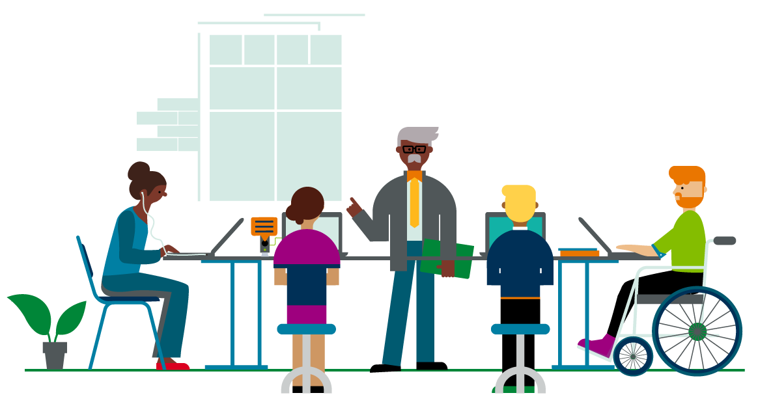
Reading, Writing, Arithmetic: Experiences of US Students with Disabilities
Michele A. Williams, PhD
Senior UX Researcher - Accessibility
CSUN Conference | March 15, 2019
Notes:
This work stemmed from joining Pearson in the capacity of researcher and advocate for accessible technology.

Slide 2
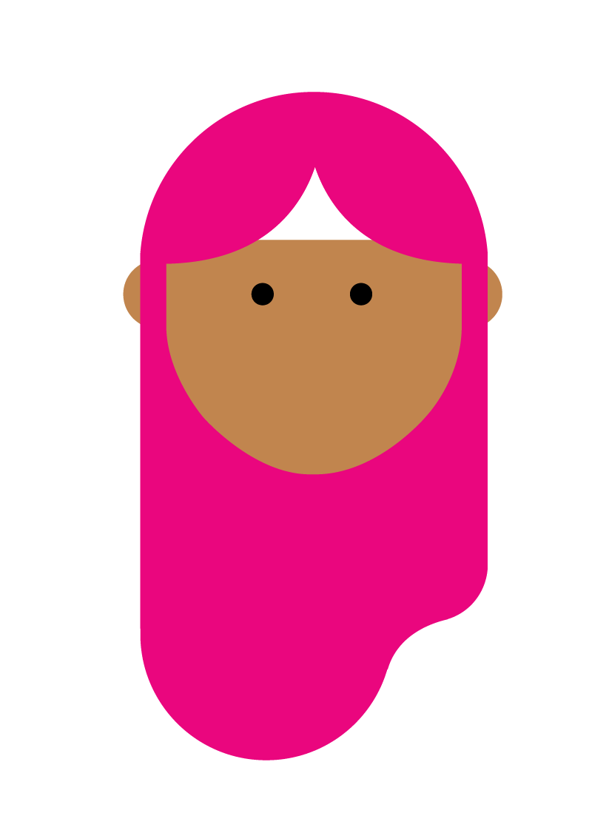
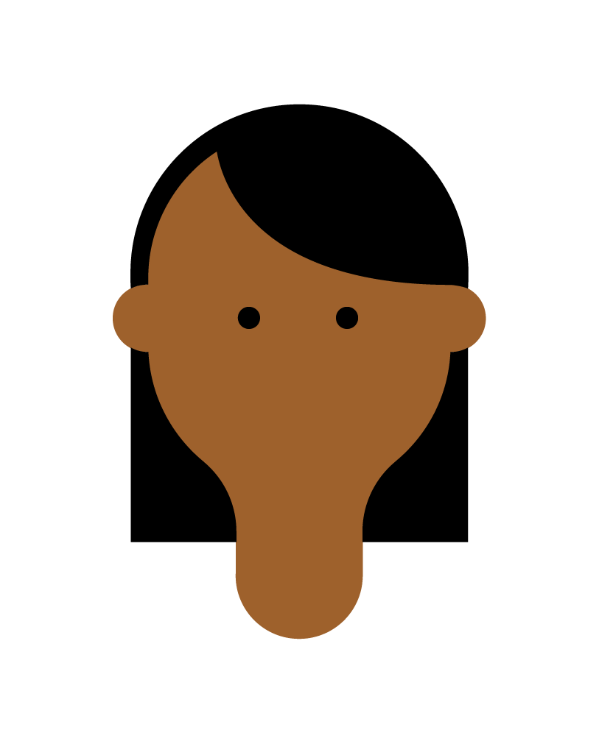
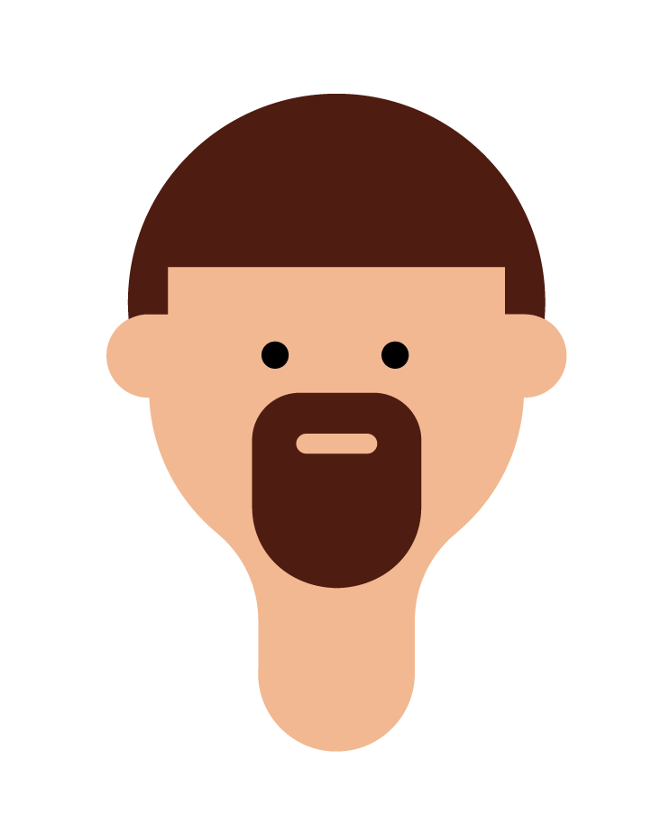
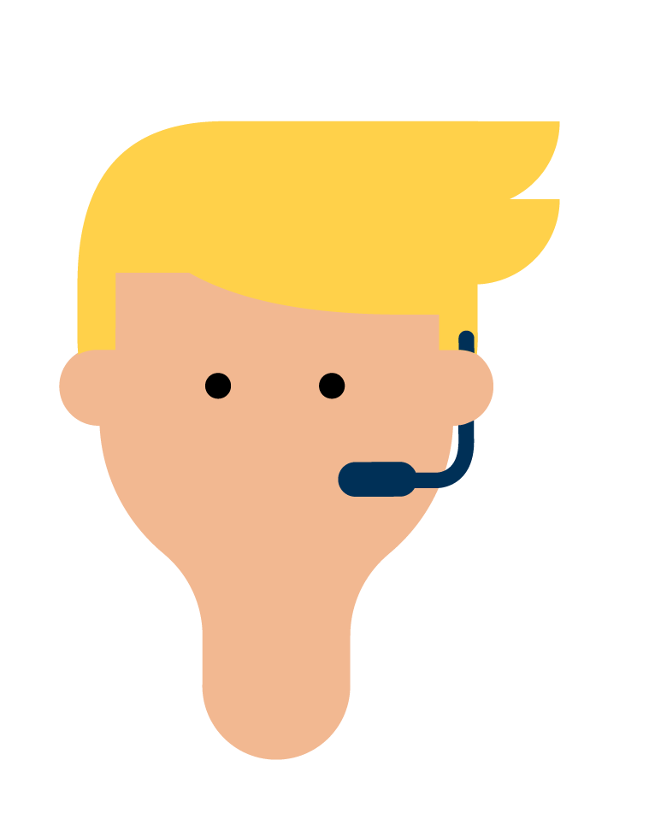
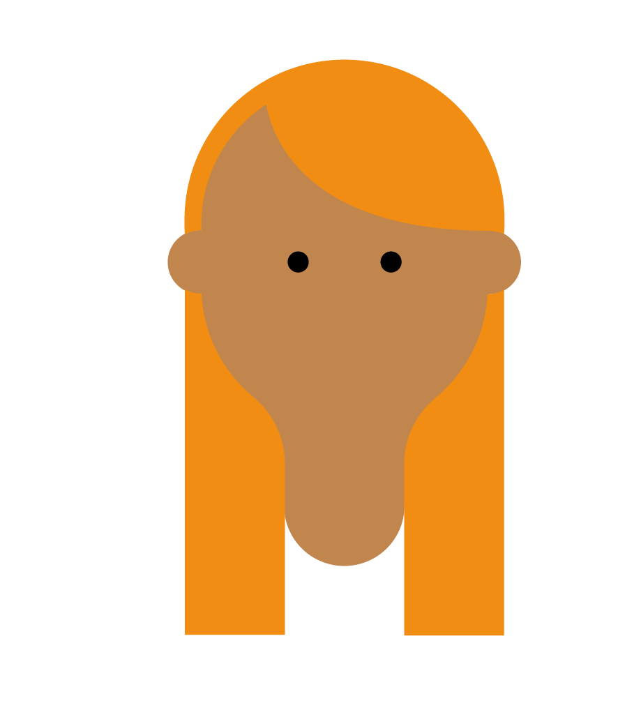


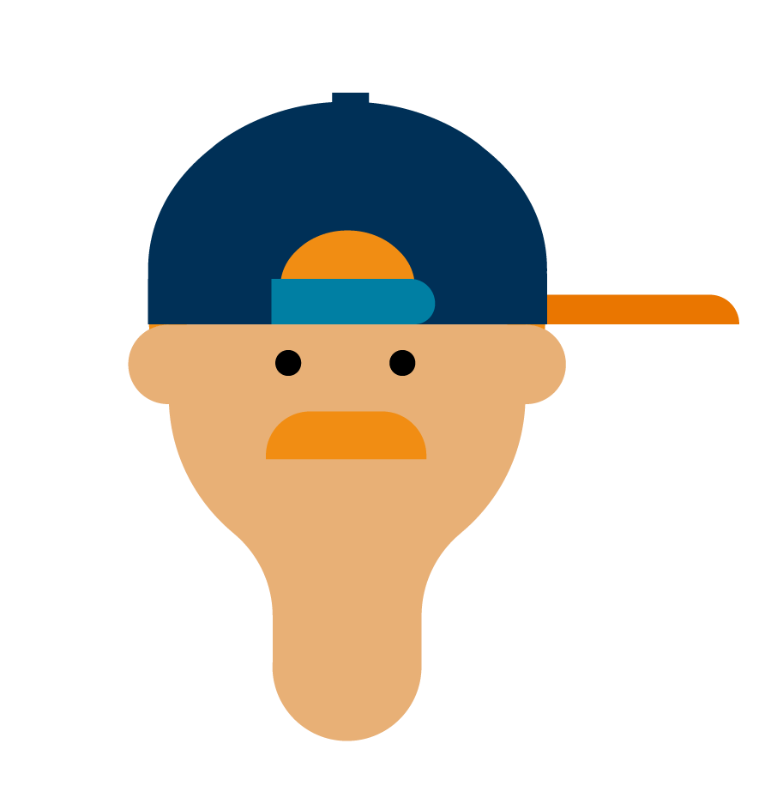
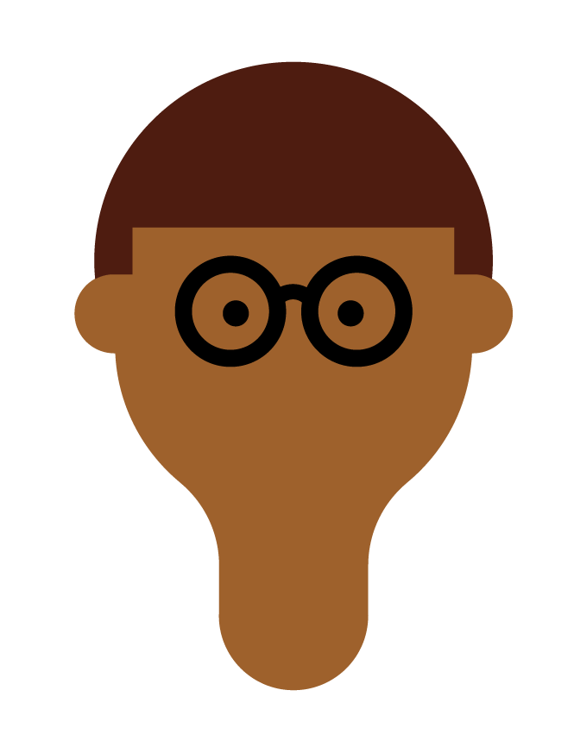
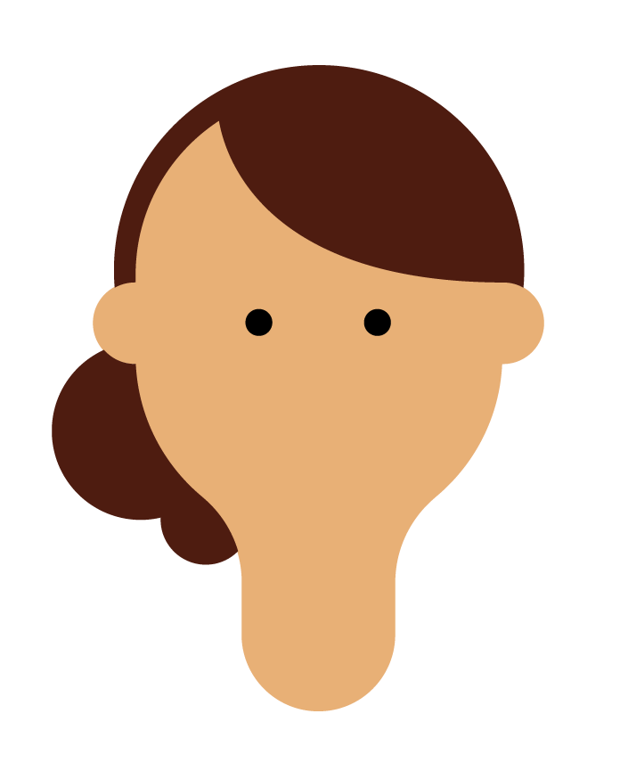

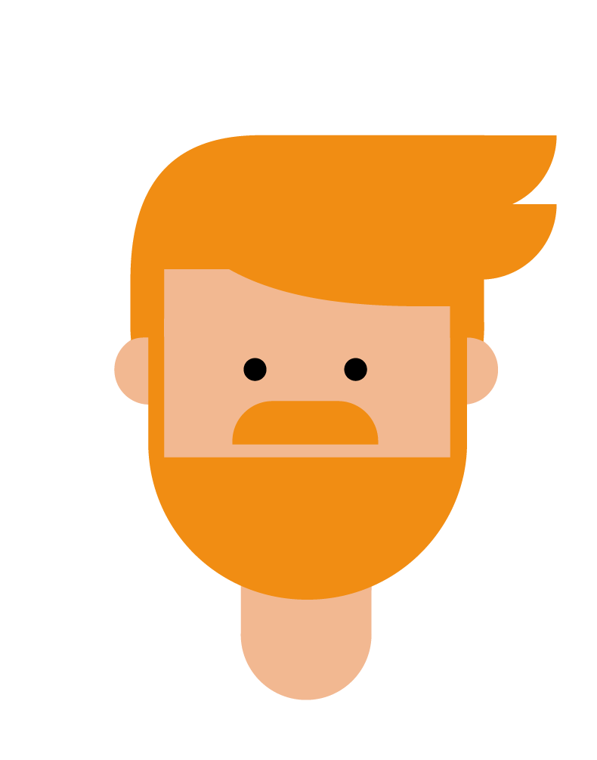

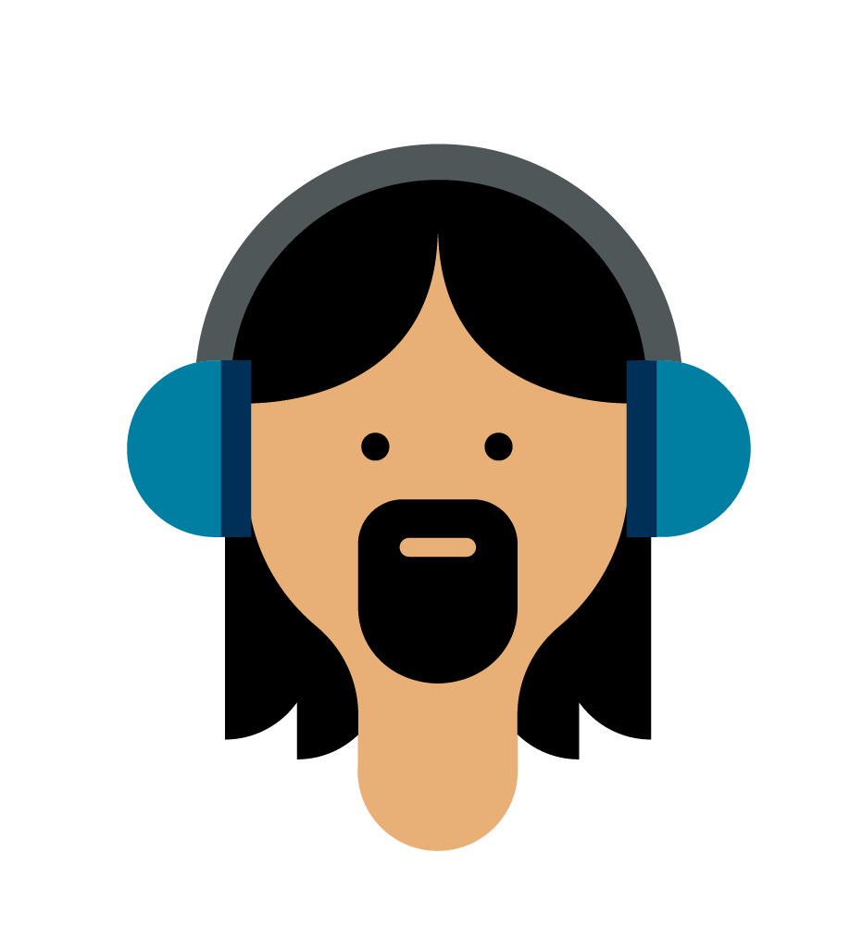
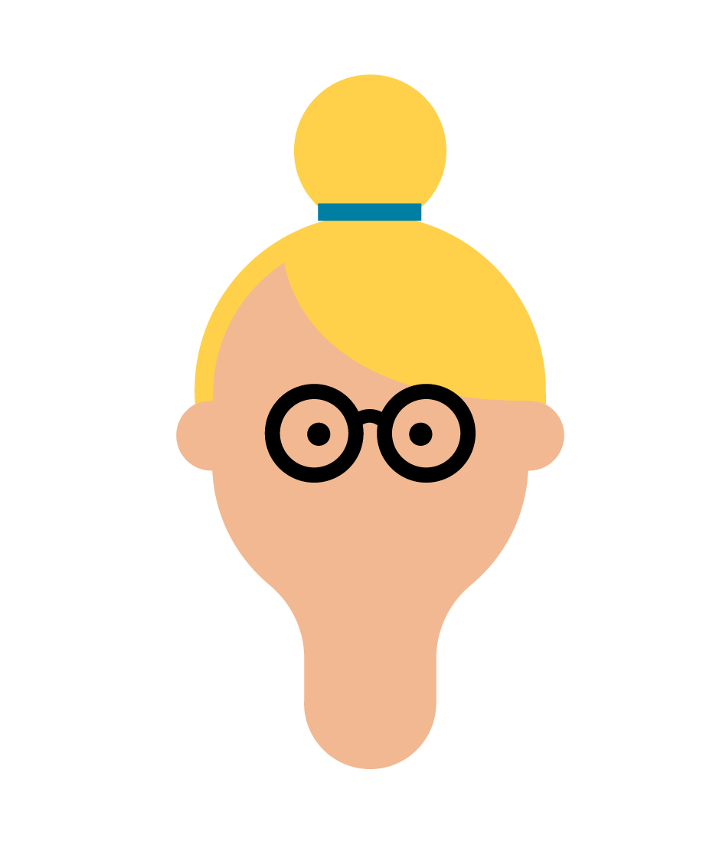
Design for Diversity
Notes:
The goal when deploying technology at a large scale is to design for diversity – particularly when talking about college students who can be literally anyone at any stage of life.

Slide 3
Personas
Betty
“Just here to learn”
Goals:
Motivations:
Personality:
James
“I’d rather party”
Goals:
Motivations:
Personality:
Sam
“Doing my best”
Goals:
Motivations:
Personality:
Notes:
A common strategy for UX teams to represent diversity is through the use of personas – personifications of qualitative and quantitative data collected about product users that help inform the features and functions of a system. I was asked when I presented this data internally if I would make for students with disabilities and I replied that it’s already been done – it’s our personas. Because personas encompass attributes such as goals, motivations, personality, these are not going to change because a person has an impairment. The students I met with fit right into some of our standard personas. However, we know that disability does impact a student above and beyond what a persona would display – that’s what this research pulls out.

Slide 4


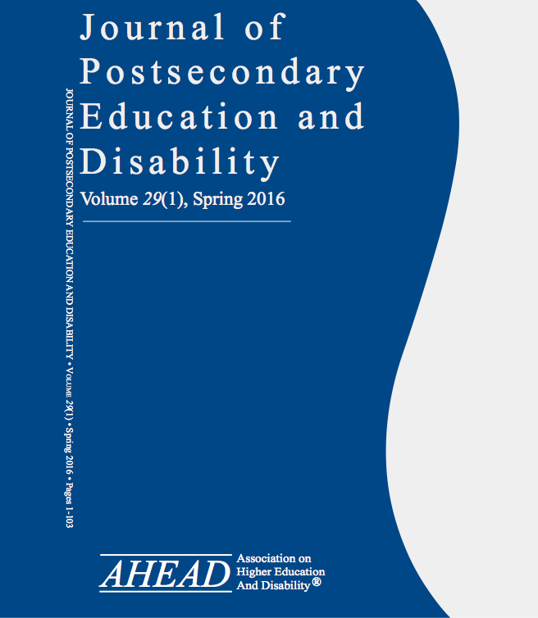
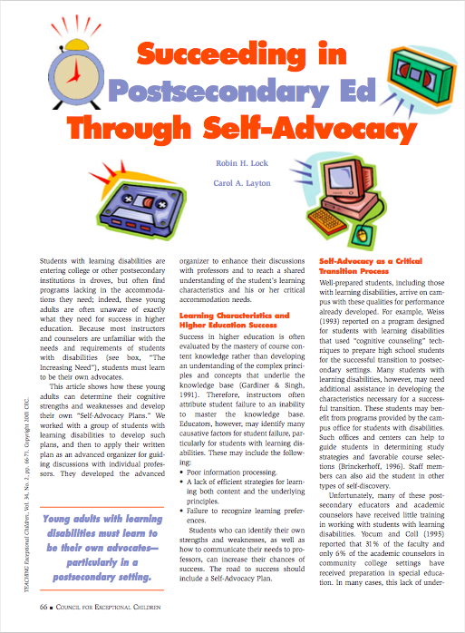
Prior Research
Notes:
As a researcher, I first looked to prior research to understand these differences.
I found, for instance, the National Longitudinal Transition Study that looked at the transition from high school to college. In that study I learned, among other things, that nearly two-thirds of those students did not report to their disability service office. While I knew about that office from working with administrators in my prior research, I didn’t realize students didn’t know about or use the services.
I also found papers on self-advocacy such as “Succeeding in Postsecondary Ed through Self-advocacy” and learned that particularly students with learning disabilities don’t know about their disability or the fact that DSS can help.
Lastly, I found several relevant papers in the Journal of Postsecondary Education and Disability regarding inclusive education, the latest in DSS office accommodations, and generally how the standards are applied in the day-to-day.
This was helpful but as a researcher, I always have questions. So initially I was just casually asking students if we could chat about their education experience. It later turned into more formal foundational research.

Slide 5
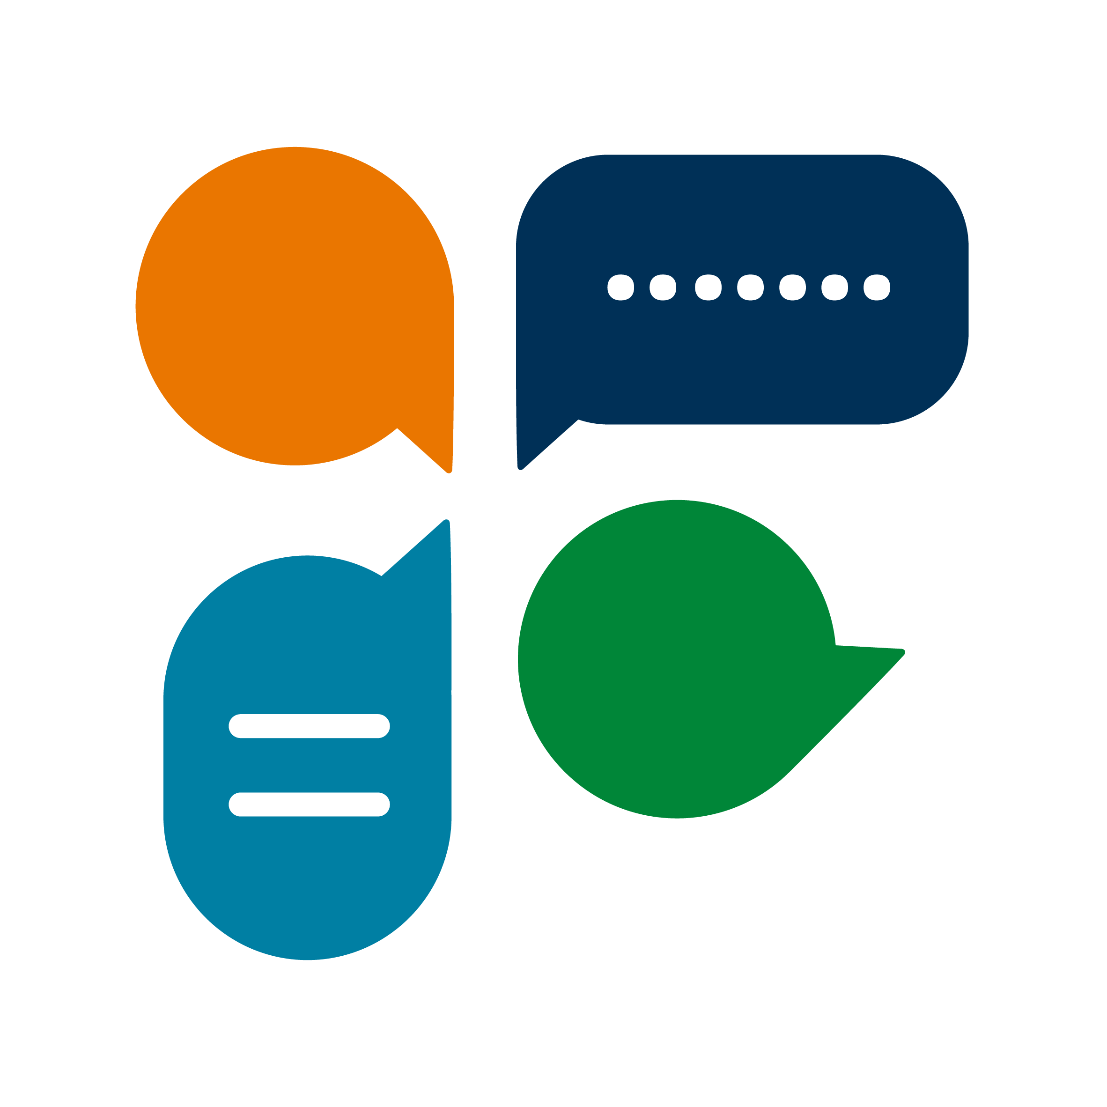

My Research
Open-ended interviews
Grounded Theory coding
Notes:
I started with very informal conversations with a handful of students, asking them to just “Tell me about” anything related to school as far back as they could recall. As I started summarizing my research, I began to notice themes as well as experiences that I realized I wanted my colleagues to know. I felt it would help them understand why I would suggest certain features or functions on our calls and also start to build their understanding which was just as important. Ultimately I began to use Grounded Theory and iteratively focused my interview questions based on the themes found in prior interviews until I had saturation.

Slide 6
Participants – Cognitive, Mobility
Age | Gender | Disability/Impairment | Major(s)
18 | Female | Brain tumor (Memory loss) | Chemistry, Art Studio
21 | Female | Cerebral Palsy, Learning disability | Peace and Social Justice
46 | Male | Cerebral Palsy, Learning disability | Mental Health and Physical Rehabilitation
21 | Female | Dyslexia | Child and Family Studies
22 | Female | Dyslexia, Language disorder | Educational Studies
31 | Male | Traumatic Brain Injury (TBI), ADHD | Nursing and Exercise
22 | Female | Tourette's Syndrome | Psychology
Notes:
This is a lot of text but just showing details about each participant – including to point out the diversity
All but one student were current undergraduates, including a few returning students; one blind student was a recent Master’s graduate student, one blind student was transitioning to graduate school

Slide 7
Participants – Mobility, Psychological
Age | Gender | Disability/Impairment | Major(s)
19 | Male | Autoimmune disease related to spine curvature | Management and Information Systems
35 | Female | Ehler's Danlos Syndrome (Connective tissue disorder) | Psychology, Theology, Public Health
56 | Female | Spine impairments including scoliosis | Paralegal/Pre-law
20 | Female | Anxiety, ADHD | History
21 | Female | Anxiety, deaf in left ear | Child and Family Studies
Notes:
Was intentional about including students with psychological disabilities as we don’t always or often consider those when reviewing designs. I also didn’t have a good sense of how that impacted a students’ school experience and the tools they use to help.

Slide 8
Participants – Vision
Age | Gender | Disability/Impairment | Major(s)
19 | Male | Convergence Insufficiency (Near vision difficulty) | Chemistry
19 | Male | Blind (full loss at age 6) | Computer Programming
24 | Female | Blind (from age 4) | Integrative Health
25 | Female | Blind (from birth) | Physics
34 | Male | Blind (from birth) | English, Public Administration
Notes:
Let’s meet some of the students in the next slides.

Slide 9

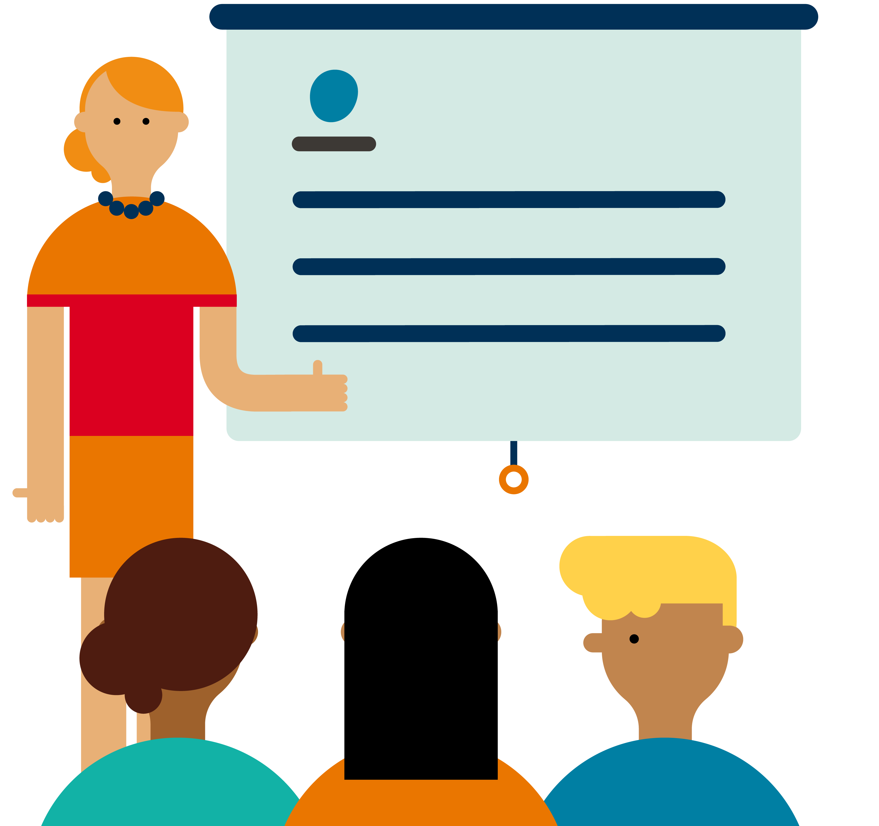

“Fred”, 34
Blind from birth
Recent graduate student
Public school to School for the Blind
Attended summer program before undergrad to get acclimated
JAWS screen reader, braille display and books
Notes:
Fred was born blind so always had accommodations in school as well as through a program his parents would take him to on the weekends at a school for the blind out of state. Eventually he moved from his public school to that school for the blind in 8th grade. He described public school as “awful” because of the teasing and just general environment of not fitting in. The School for the Blind being out of state took a lot of getting used to at a young age but he adjusted quickly because he felt understood and that he could be himself.
In college he knew to go to DSS and for undergrad even attended a program to start school in the summer with a smaller cohort of students. This helped him get familiar with campus from a navigation standpoint as well as college course loads before the Fall chaos. The various DSS offices he experienced throughout school were not always helpful, however, and one such office’s lack of accommodations (based on what he thought he should receive) lead to him leaving the school and not finishing one of his graduate degrees.
From the accommodations in K-12, he was very proficient in his JAWS screen reader and pretty much knew what he needed to do to get his work done. He would find a few things didn’t work (like SPSS) but overall he could overcome anything not accessible with a cooperative instructor or tutor, especially for math. To date he has an undergraduate and 2 master’s degrees.

Slide 10

“Henry”, 46
Cerebral Palsy
Returning undergraduate
Family friend led to adaptive sports after significant surgery
Didn’t use didn’t know all-in
Touchscreen computer/tablet, voice dictation
Notes:
Henry was born with Cerebral Palsy. At age 14 he had a surgery that was supposed to help his labored walking but ended up putting him in a wheelchair. This lead to depression until a family friend introduced him adaptive sports and that turned things around. He still keeps up with various leagues even now.
The same family friend encouraged him to go to college so he started with an associates in the 1990’s. At first he didn’t ask for any accommodations but after having a 2.9 GPA he says he “let his pride go” and asked them for help. This lead to a 3.7 GPA and successful degree completion. However, he didn’t quite know how to advocate for himself when started his Bachelors at a much larger university, so he didn’t make it past his first semester in that endeavor. He’s later come to realize he likely has a learning disability that he didn’t realize back then. He’s now returning to school partly to learn about his disability and help others, and now he’s armed with a lot more resources from the disability community group he’s found in his state and knowing more about the DSS resources available through the state agency advocates he’s met through the years.
The advancement in technology also helps – he loves his touchscreen device since it fits on his chair easily and it easier to use with his muscle fatigue. He also sometimes uses dictation software for talking through longer papers. Overall he’s trying to “better his living” by going back to school as a non-traditional student.

Slide 11
“Jessica”, 22
Tourette’s Syndrome
Traditional undergraduate
No interventions, told to study harder
Misdiagnosed by doctor initially
No technology helps currently
Notes:
Jessica has been dealing with the effects of Tourette’s Syndrome for as long as she can remember but only recently could put a name to her experience. Throughout elementary and middle school she thought it was normal to take upwards of 3-4 hours to read and do her homework. She didn’t give much thought to the cold chill sensation she would often feel, especially since she didn’t want to get called out by her classmates. Also, her eyes rolling in her head while she read didn’t really register with her at first – again she didn’t know this wasn’t normal and her parents didn’t suspect anything either.
Unfortunately, when she finally did go to a doctor in high school when the homework backlog became overwhelming, she was misdiagnosed and put on medication that has since left her with memory loss as a side effect. She would eventually be correctly diagnosed late in high school but at that point she just continued to push through the way she had given no one had many other ideas on how to overcome her difficulties.
Now in college, she’s registered with the DSS and has accommodations like extra time but that only helps so much. She actually has not found any good solutions to help her because the mechanical voice on the TTS software the school provides actually activates her tics, and her school primarily uses PDF’s for the text, nothing with an audio book option. She’s actually still struggling a lot and it doesn’t help that things like being tired also trigger her tics. She’s hoping something will give soon so she can achieve her goals.

Slide 12

Disability Impact Categories
K-12 Experience
Social Network
Accommodations
Study Workspace
Assistive Technology
Notes:
From the research came the following themes or categories; these are the areas where disability had an impact that varied from our personas.

Slide 13
Categories & Attributes
K-12 Experience
Social Network
Diagnosis:
None or Not applicable
Early or late
(In)correct
Learning Tools:
Not accommodated
Tactile graphics
Literacy software
Adaptive instruction, etc.
College Preparedness:
(Not) Aware of disability
(Not) Aware of assistive tools and techniques
Family:
Helpful or harmful
(Not) Knowledgeable
Disability Organizations:
(Not) Affiliated
(Do not) Utilize
Disability Office:
(Not) Aware
(Not) Helpful
Notes:
As you can tell, even though the categories were overlapping, not everyone's experience was the same. Thus, within each category is a set of attributes to capture the diversity.
One example to keep in mind is the Family section of Social Network. Sometimes family or someone close is the cause of a disability, particularly in the case of a psychological disability due to abuse or neglect. This can come into play with areas like the security questions for a lost password – assuming someone knows their mother’s maiden name or had a pet, etc. \

Slide 14
Categories & Attributes (cont’d)
Accommodations
Study
Workspace
Equipment:
Large braille book
Large monitor, etc.
Ergonomics:
Special chair or mouse
Need to move around
Environment:
Quiet, alone
Allow audio input & output
Assistive
Technology
Self-Advocacy:
(Do not) Have
(Do not) Use
Effectiveness:
(Not) Helpful
(Not) Sufficient
Types:
Extra time on tests
Student notetaker
Absences, etc.
Types:
Hardware or Software
Level of Necessity:
Struggle → Must-Have
Technical Knowledge:
Novice – Intermediate – Advanced
Funding:
Self or Family
School or Government

Slide 15

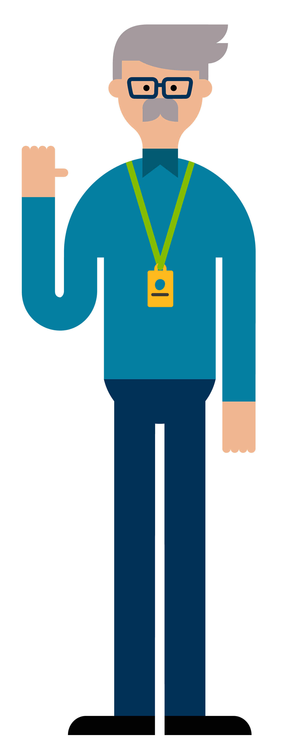
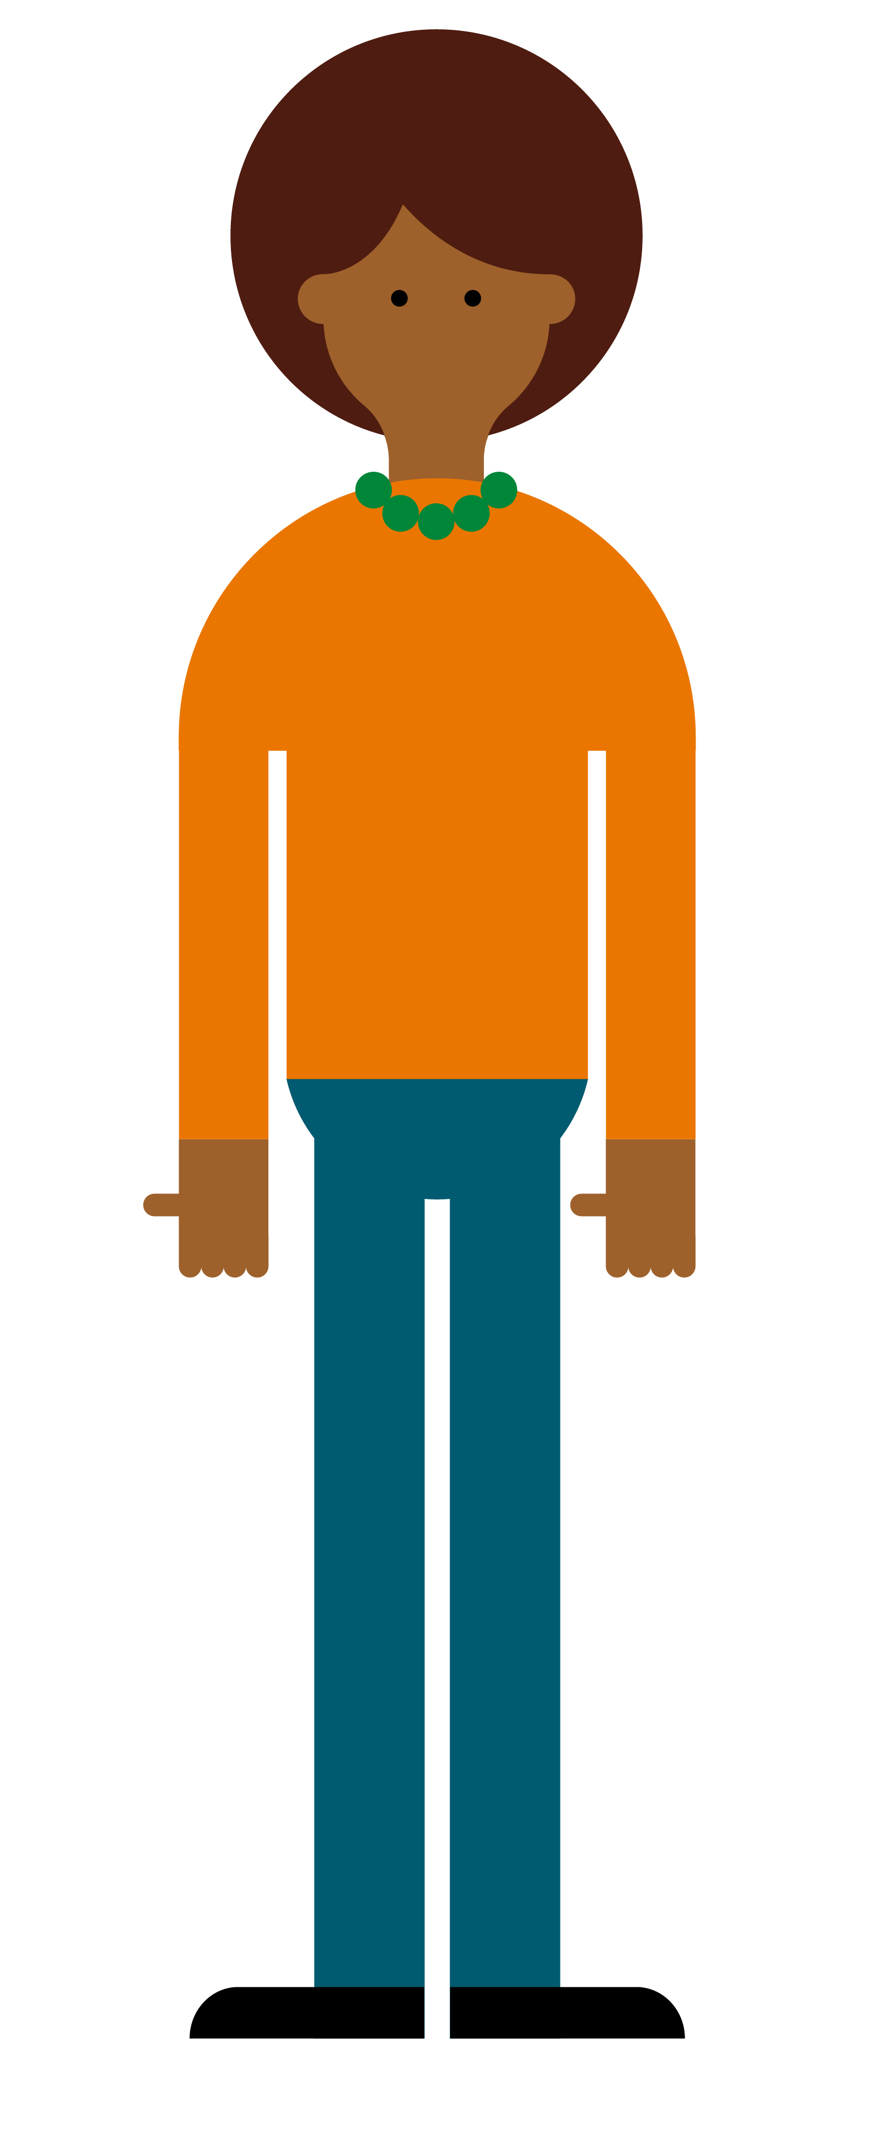
Applying the Categories
Pearson systems include:
Instructor
Onboarding
Account Management
Assignment management
Gradebook
Student
Onboarding
Account Management
Course material
Assignment management
Notes:
Our software fits into an ecosystem so it’s important to understand how these impact our design and development

Slide 16
User Interface Impacts
Study Workspace
Attribute:
Ergonomics - need to move around
Consideration:
Automatic system timeouts
Opportunity:
Timeout system warning, smarter placement back in system
Accommodations
Attribute:
Type – extended absences
Consideration:
Instructor settings
Opportunity:
Ensure extending dates for individual students is available and easy to find
Attribute:
Family – harmful
Consideration:
Sensitive content
Opportunity:
Consider trigger warnings for sensitive content
Social Network
Notes:
Here are a few examples of how we might use these categories and attributes to influence design.

Slide 17
Disability Impact Categories
K-12 Experience
Social Network
Accommodations
Study Workspace
Assistive Technology
Notes:
This may not be enough information to get you off and running, but hopefully it provided some food for thought and will spur you on to do similar research as well as think more broadly and deeply about the impact of disability in the systems and programs in which you have influence.

Slide 18
Paid Research Projects
Sign-up online to participate in a variety of research projects
Complete the following survey and we’ll reach out for the next study that’s a match for you.
https://www.surveymonkey.com/r/PearsonA11yUserStudies

