Slide 1
Tactile Graphics: Teacher Perceptions of Students with Visual Impairments
Ashley Nashleanas, Ph.D.
Shari Butler, Ph.D.
Jan McSorley
The 34th CSUN Conference on Assistive Technology

Slide 2
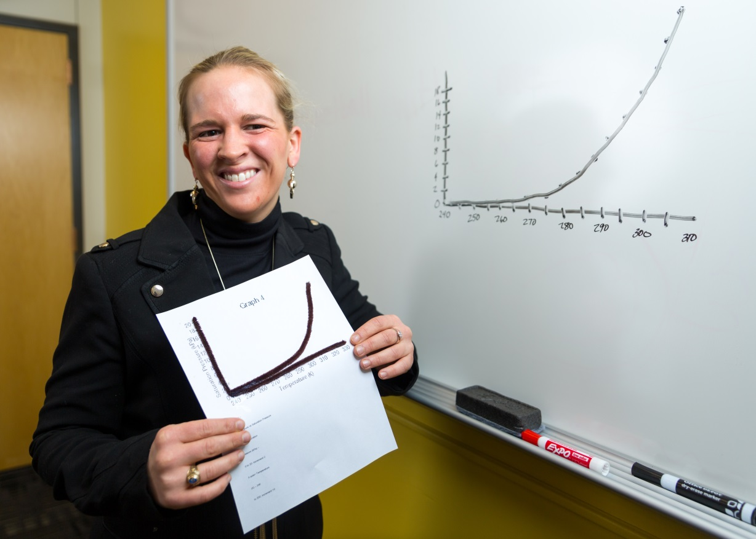
Introduction
About Myself
Focus on teacher perceptions with regard to three questions
Do SVI explore graph elements in the same way as their sighted peers?
What role does prior visual experience play in teachers’ perceptions of task performance?
Who can be helpful to SVI in learning about graphs?

Slide 3
Overview of Presentation
Summarize on graphing for SVI and support systems
Describe two studies
Report results based on teachers’ perceptions of SVI exploration of tactile graphs, role of visual experience, and resources
Recommendations for practitioners
Recommendations for future work
Q and A

Slide 4
Review of the Literature
Literature on students with normal vision -- Pinker (1990)
SVI and spatial information -- Millar (1994)
SVI and graphing -- Zebehazy and Wilton (2014), Rosenblum, Cheng, and Beal (2018)
Role of visual experience on spatial tasks -- Dulin and Hatwell (2006) and Papadopoulos, Koustriava, and Kartasidou (2011)
Teachers who serve SVI -- McKenzie and Lewis (2008)

Slide 5
Survey of TVI Perceptions
Web-based survey
TVI perceptions of graphing for SVI
Participants
34 TVI from 21 states and Canada
Data collection
April 2017 to February 2018
Survey items
Tactile graph exploration
Role of visual experience on completing graphing tasks

Slide 6
Interviews with TVI Perceptions
Interviews
to understand teacher perceptions of support for SVI and graphing
Participants
4 TVI
2 mathematics educators
Interview questions
Data collection -- May of 2017 to March of 2018
TVI perceptions of SVI needs and teacher facilitation

Slide 7
Findings Pertaining to Graph Exploration
Do SVI explore graph elements in the same way as their sighted peers?
Literature gap for how SVI explore tactile graphics
Survey items on SVI at beginning and end of exploration process
TVI responses
SVI focus on function before referents
Interviews
Teachers perceived SVI attend to referents before function
Implications For Practice
Guide with both hands and verbalize each component

Slide 8
Findings Pertaining to the Role of Visual Experience on the Quality of Solving Graphing Tasks
What role does prior visual experience play in teachers’ perceptions of task performance?
No published literature for impact of visual experience on accuracy of completing graphing exercises
Survey -- related demographics to teachers' perceptions of impact of visual experience on task performance
Onset of VI
TVI with more experience perceived previous vision perform graphing tasks more accurately than blind
Level of VI
TVI with more experience perceived low vision were able to use graphs more accurately than total blindness
Interviews
TVI perceived minimal experience are capable of understanding graphs

Slide 9
Findings Pertaining to the Role of Visual Experience on Quality of Solving Graphing Tasks Con’t
Results
Natty's perception
Her student's memory and ability to use assistive technology
Lois' perception
Her student's independence
To summarize -- students with minimal vision are capable when provided with proper technology and instruction

Slide 10
Results Pertaining to Beneficial Training Resources
Who can be helpful to SVI in learning about graphs?
Literature suggests TVI as main resource, but interview data suggest multiple resources
Results
Kenny
Paraprofessional reinforced verbal description
Lois
Paraprofessional provided information on when and how to produce tactile graphics
Lydia
Consultant held sessions on TVI teaching SVI to work with multiple types of technology
To recap -- individuals new to teaching SVI can benefit from those with previous experiences

Slide 11
Recommendations for Practitioners around Teachers’ Perceptions of SVI and Graphing
Graph exploration
SVI explore tactile graphics through verbal communication and guiding with both hands
Role of visual experiences
Students with limited vision are capable with proper combination of technology and instruction
TVI, paraprofessionals, and consultants are able to serve SVI

Slide 12
Recommendations for Future Work
Tactile graphics and the role of visual experience
TVI sharing resources with mathematics educators
TVI learning from mathematics educators

Slide 13

Questions? Thank you! ashleynashleanas@gmail.com http://accessibility.pearson.com/assessment/conferences/csun2019.html

